Slide 2

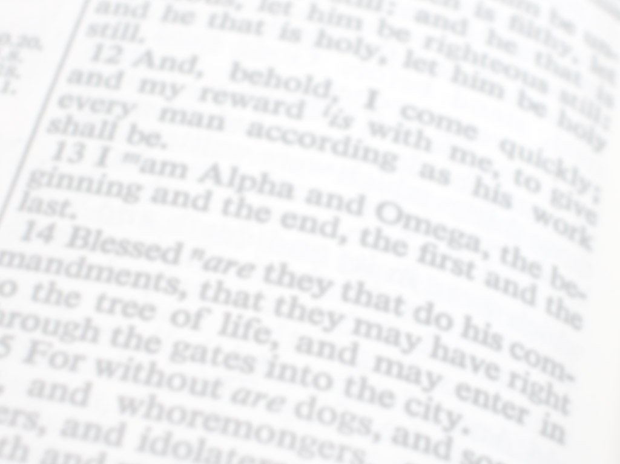
"If you see a blind man, kick him; why should you be kinder than God?"
WRONG!

Slide 3
God is Not a Tormenter
He is a Comforter
2 Corinthians 1:3
James 1:17

Slide 4
Would YOU Kick a Blind Man?

Slide 5

Most of The Things That Happen in This World are NOT God’s Will

Slide 6
God’s Will is that All Men Be Saved
1 Timothy 2:3-4
2 Peter 3:9
Jesus Says Not ALL will Come to Repentance
Matthew 7:13,14

Slide 7
If Such Things are Attributed to God, How Can we Expect People to Love Him?

Slide 8
The Book of Job
Luke 13:2
It is a False Theology Which Holds that Everything in Human Lives Happens, Because God Wills It

Slide 9
Most of The Things That Happen in This World are NOT God’s Will

Slide 10
The Book of Job
Luke 13:2
It is a False Theology Which Holds that Everything in Human Lives Happens Because God Wills It
We can Learn; be made Stronger; be Drawn Closer to God.

Slide 11
Jesus Heals a Paralytic
John 5:14
False Assumption
John 9:2,3

Slide 12
A Suggestion About Punctuation
John 9:2-4 2 And His disciples asked Him, saying, "Rabbi, who sinned, this man or his parents, that he was born blind?" 3 Jesus answered, "Neither this man nor his parents sinned. But that the works of God should be revealed in him, 4 "I must work the works of Him who sent Me while it is day; the night is coming when no one can work.

Slide 13
The Work of God is Not to Blind & Blight
It is to Help & Heal!
John 9:7

Slide 14
Life Isn’t Always Fair
Job 21:6-16
Luke 16:19-31
James 1:3
Matthew 5:45

Slide 15
Qualities and Environment You Would Need to be the Ideal Environment
1.Law-Abiding World -- Genesis 1:26
2. Challenging Environment
3. Certain Survival Mechanisms Awaken People to Fundamental Needs

Slide 16
Every Instance of Human Suffering Results From Some Quality of This World Which is Necessary For Making it a Proper Environment For Human Life

Slide 17
What Would YOU Change?

Slide 18
How Should We React To Suffering?
Don’t Blame God -- Job 1:22
Accept What You Cannot Change
Change What You Can
Romans 6:14
Hebrews 13:5
Ephesians 3:14-19; Romans 8:9-11

Slide 19
How Should We React To Suffering?
4. Realize You Are NOT the FIRST – or LAST 1 Corinthians 10:13a
5. Trust God For Deliverance 1 Peter 5:7
1 Corinthians 10:13b

Slide 20
Would YOU Kick A Blind Man?

